Slide 1
COSTAPP
COMMERCIAL CONTROL FOR LIVE CONSTRUCTION PROJECTS
One project.
One commercial position.
One controlled record.
COST
CHANGE
COMMUNICATION
Cost planning, CVR reporting, contractual change, subcontract payments and project communications, connected in one secure workspace.
KEVIN MORLEY MCInstCES
CONTROL THE COST | MANAGE THE CHANGE | SEE WHERE THE PROJECT FINISHES
costapp.co.uk

Slide 2
COSTAPP
02
THE PROBLEM
COMMERCIAL CONTROL IS OFTEN FRAGMENTED
01
Disconnected records
A project can have the data, but still lack the complete position.
The cost, change and correspondence position can drift apart.
02
Manual monthly reporting
QS time is spent rebuilding information that already exists.
Cost plans, change registers, payment records and formal communications are frequently managed in separate files, inboxes and individual laptops.
03
Limited director visibility
The current position is difficult to review without asking the project team.
CONTROL THE COST | MANAGE THE CHANGE | SEE WHERE THE PROJECT FINISHES
costapp.co.uk

Slide 3
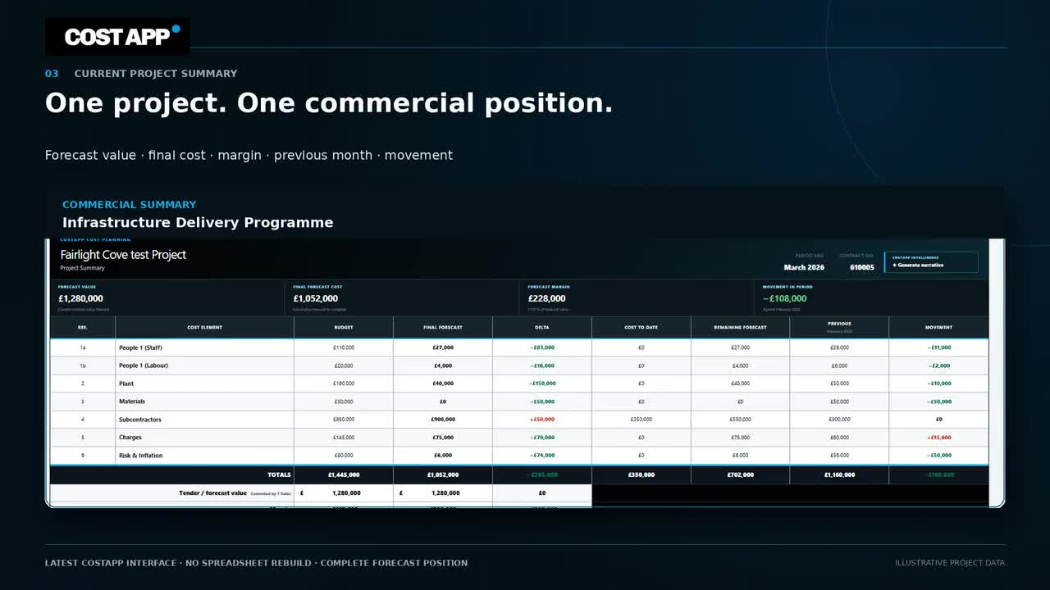
COSTAPP
03
COST PLANNING
A LIVE COMMERCIAL MODEL
Plan every month, then let actual cost replace forecast.
Costapp holds budget, actual cost, remaining forecast and value in one structured monthly position.
BUDGET + ACTUAL + FORECAST + VALUE
CONTROL THE COST | MANAGE THE CHANGE | SEE WHERE THE PROJECT FINISHES
costapp.co.uk

Slide 4
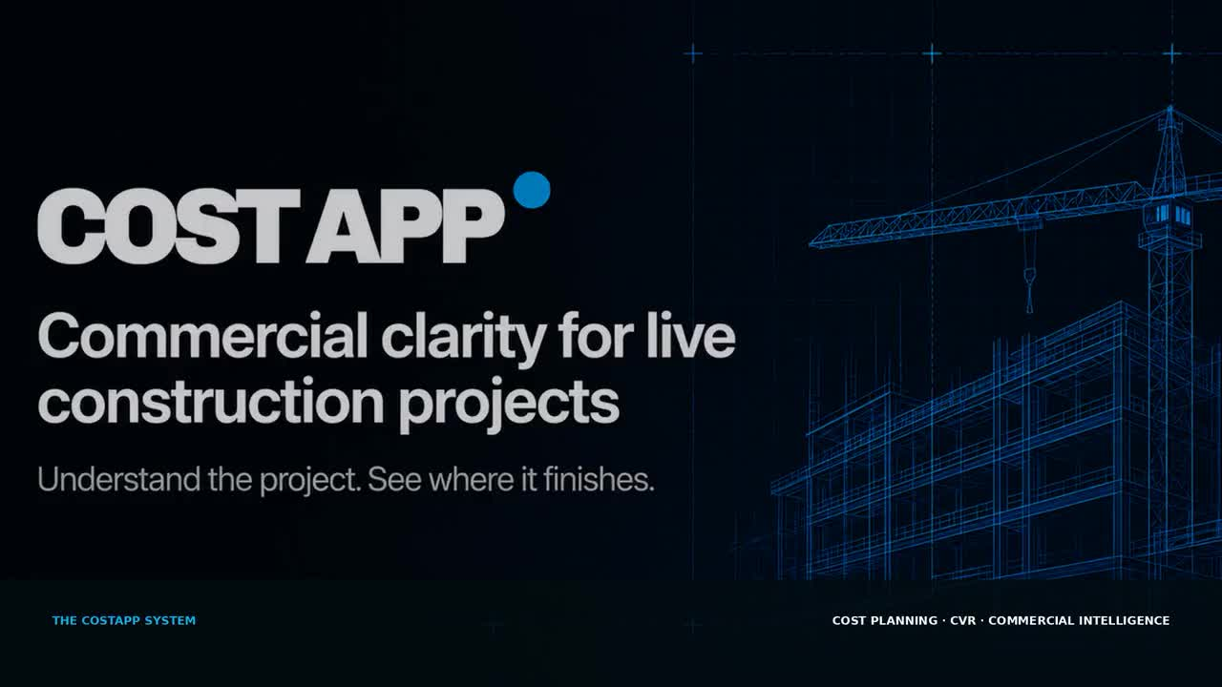
COSTAPP
04
ACTUAL COST
STRUCTURED COMMERCIAL DATA
Turn the contractor's cost export into the Schedule of Cost Components.
Upload the monthly cost file, validate the totals and place actual cost into the correct commercial structure, without rebuilding the ledger by hand.
CONTROL THE COST | MANAGE THE CHANGE | SEE WHERE THE PROJECT FINISHES
costapp.co.uk

Slide 5
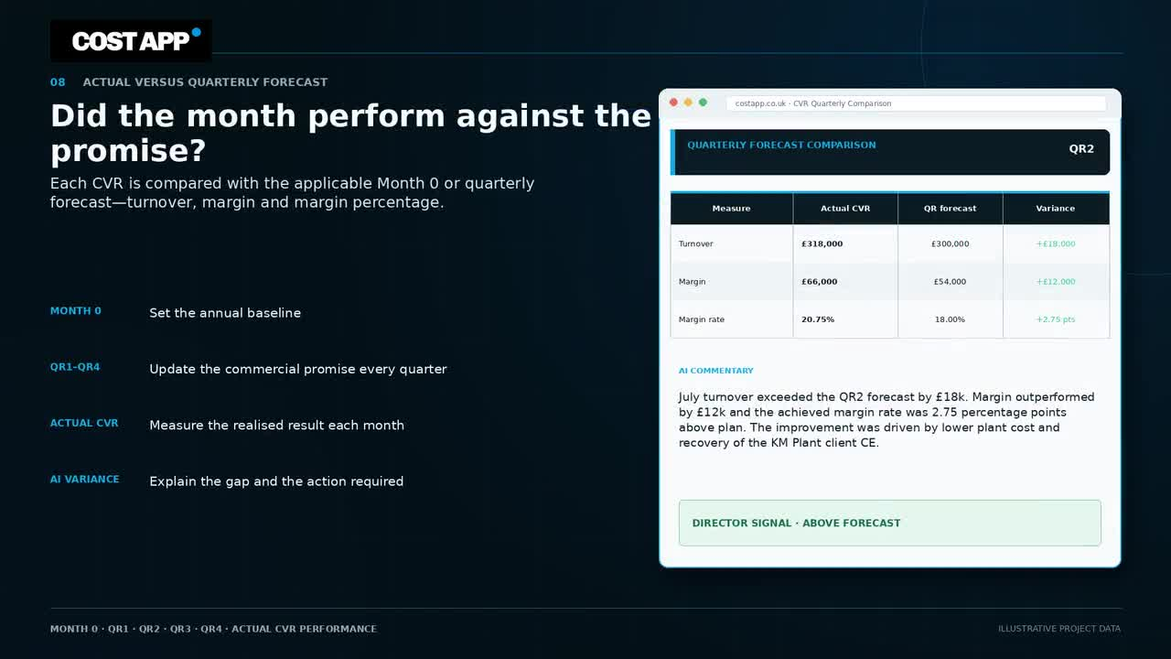
COSTAPP
05
CVR AND REPORTING
DIRECTOR-READY VISIBILITY
The monthly position becomes a complete CVR story.
Costapp brings turnover, cost, margin, forecast movement, cost movement narrative, cashflow and quarterly performance into a consistent review.
AI-ASSISTED CVR POPULATION AND NARRATIVE
CONTROL THE COST | MANAGE THE CHANGE | SEE WHERE THE PROJECT FINISHES
costapp.co.uk

Slide 6
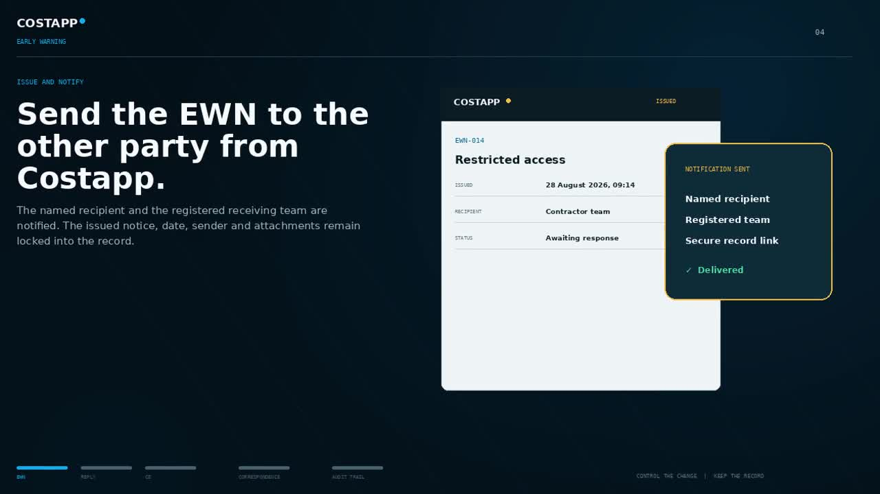
COSTAPP
06
CONTRACTUAL CHANGE
BOTH CONTRACTING PARTIES
Early Warnings and Compensation Events move in both directions.
Contractor and subcontractor teams work from the same project, with the correct notices, replies, quotations, assessments and implementation actions shown to each party.
CONTROL THE COST | MANAGE THE CHANGE | SEE WHERE THE PROJECT FINISHES
costapp.co.uk

Slide 7
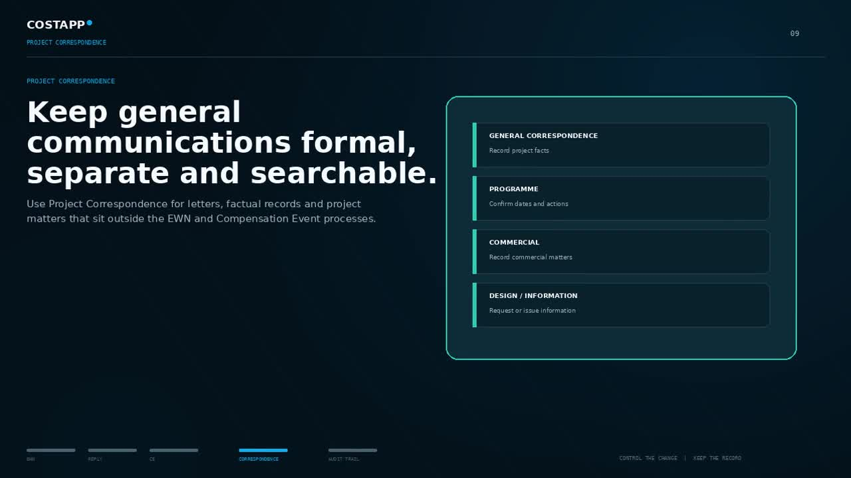
COSTAPP
07
PROJECT COMMUNICATIONS
COMPLETE PROJECT RECORDS
Formal correspondence stays separate, searchable and connected.
Letters and factual records that sit outside the EWN and Compensation Event processes receive a permanent number, secure issue record, replies, attachments and audit history.
CONTROL THE COST | MANAGE THE CHANGE | SEE WHERE THE PROJECT FINISHES
costapp.co.uk

Slide 8
COSTAPP
08
SUBCONTRACT PAYMENTS
PAYMENT CONTROL
APPLICATION
The subcontract payment cycle feeds the commercial position.
PAYMENT CERTIFICATE
Applications for Payment and contractor payment certificates remain on record, with due dates, issue dates and monthly liability available to the QS for review and amendment.
COST PLAN LIABILITY
CONTROL THE COST | MANAGE THE CHANGE | SEE WHERE THE PROJECT FINISHES
costapp.co.uk

Slide 9
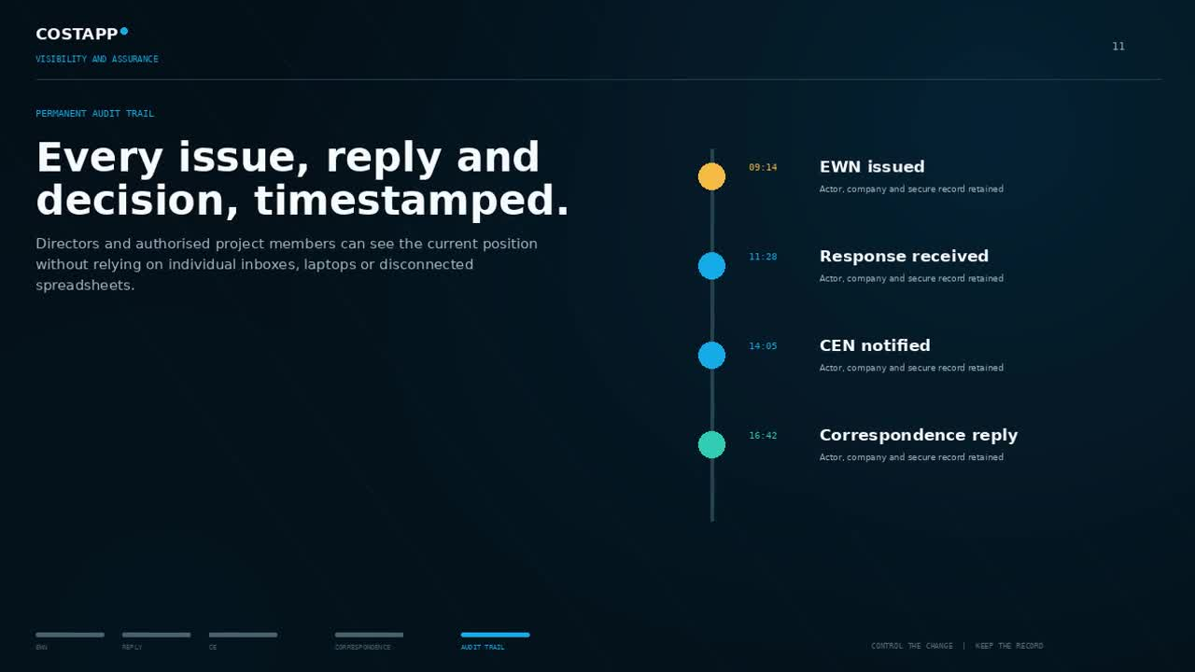
COSTAPP
09
CONTROLLED WORKSPACE
ONE PROJECT, EVERY MODULE
The commercial record stays central, with access controlled by role.
Directors can review the position remotely. Project teams contribute within their permissions. Contractor and subcontractor records remain with the correct contract and package.
CENTRALISED | PERMISSIONED | TIMESTAMPED
CONTROL THE COST | MANAGE THE CHANGE | SEE WHERE THE PROJECT FINISHES
costapp.co.uk

Slide 10
COSTAPP
TRY COSTAPP ON A LIVE PROJECT
See the complete commercial position, before the project surprises you.
14 DAYS
FREE TRIAL
£39 per month + VAT after trial
Start with one project. Keep your existing controls. Let Costapp connect the cost, change, payments and project record.
START AT COSTAPP.CO.UK
CONTROL THE COST | MANAGE THE CHANGE | SEE WHERE THE PROJECT FINISHES
costapp.co.uk

